Slide 1
Sarah Noble
Head of Early Engagement and enrolment
The work that shapes our world | RICS - YouTube

Slide 2
Objectives:
1) to understand what a surveyor does
2) to know who RICS is/what RICS does
Outcome: design a sustainable build
Notes:
At this point run a quick poll of who knows what a surveyor does and what RICS is/does – you will redo this at the end and hopefully, at the end, should see more hands up.

Slide 3
Prepare task 1
Come up with a definition of a surveyor.

Slide 4
A surveyor is a professional who…..
provides professional advice on a range of construction-related matter
ensures that new-build properties are built to regulations and specifications
ensures that stages at concerts are erected to regulations and specifications
advises on maintenance and repair of existing structures
assesses damage for legal and insurance purposes
values property (buildings, machinery and other “things”)

Slide 5
Prepare task 2
What do you think RICS stands for?

Slide 6
What do you think RICS stands for?
Really icky cheese selection
Really interesting children’s stories
Rusty iron car scraps
Royal Institution of Chartered Surveyors

Slide 7


Want to save the planet with your innovative ideas?
What to leave a legacy?
Love to doodle, sketch and draw?
Got a head for heights?
Like a heated discussion?
Enjoy tinkering with numbers?
Think drones and tech in general is cool?
Do you come up with cool ideas when day dreaming?
Think the backgrounds in computer games are awesome?
then, be a surveyor!

Slide 8


Why should
I be a
Chartered
Surveyor?

Slide 9
What is a Chartered Surveyor?
Surveyor v chartered surveyor
Footballer v Premier League footballer
Asda Jaffa Cake and a McVities Jaffa Cake
Superdrug mascara v Maybelline mascara
My SEAT v a Lamborghini
RICS is the “club” that Chartered Surveyors belong to. The organisation that “regulates” (makes sure that they follow the rules and keep up their training).

Slide 10
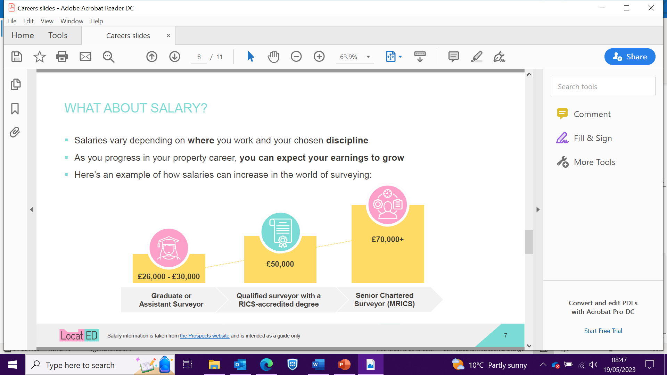



Salary
Starting salaries
Senior
Chartered
Surveyor
£50,000+
UK average salary, depending on
geographical location and discipline
Experienced
Surveyor
£38,000
Doctor
£28,808
Surveyor
£27,000
Teacher
£25,714
Journalist
£12,000

Slide 11

Travel
Surveyors are
in demand
around the globe
Get chartered and
see the world!

Slide 12
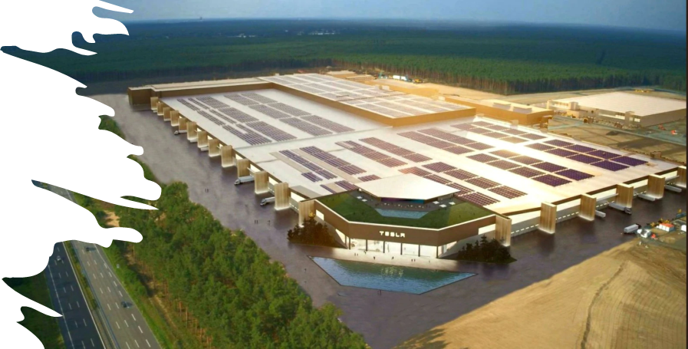

Cool gigabuilds
Tesla gigafactory in
Germany
$500m Saudi hotel: giga-project still on track for 2024

Slide 13
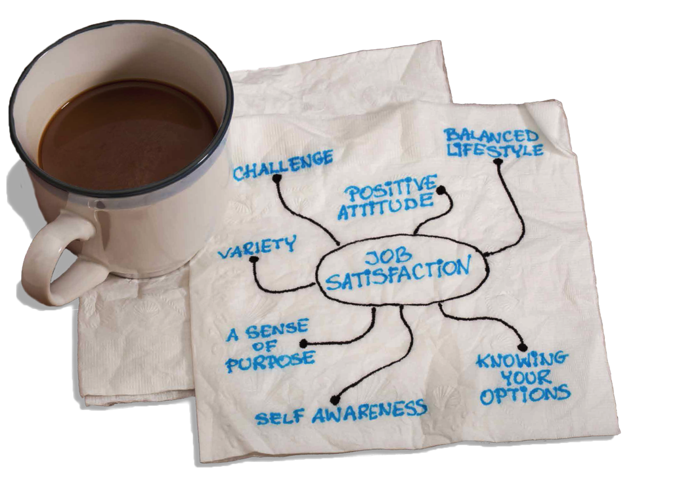
Lifestyle
No two days
are the same!
High level of
job satisfaction
A life outside work

Slide 14

What kind of
Chartered
Surveyor
should I be?

Slide 15
1 | Land surveyor | A | provide expertise across projects in real estate, land and construction. They assess the environmental challenges faced by developers, landowners and investors. Key areas include environmental management, land use and contaminated land and environmental auditing.
2 | Environmental surveyor | B | measures the shape of the land, and gather data for civil engineering and construction projects.
3 | Rural Practice surveyor | C | specialise in land or property intended for business use, which ranges from shops and offices to warehouses and depots; residential surveyors in land or property for living purposes; and rural surveyors in a combination of the two, often working on farmland and country estates.
4 | Quantity surveyor | D | assess, design and manage development projects in towns, cities and rural areas.
5 | Party Wall surveyor | E | responsible for assessing the quality of buildings, from houses to public and commercial properties. They examine the condition of buildings and advise on ways to improve them.
6 | Planning and Development surveyor | F | keep a close eye on project finances and contractual relationships. They make sure that the financial position of construction projects is accurately reported and controlled effectively.
7 | Valuation surveyor | G | carries out valuations on residential, commercial or industrial property, and organises its sale or rent and advises on investment, development and management of properties. They may be called commercial or residential surveyors.
8 | Commercial surveyor | H | inspect properties that are being bought and sold, to highlight any potential issues the property may have. Property surveys are an optional, but highly recommended part of the home buying and selling process, as it gives everyone involved peace of mind and avoids any unexpected surprises .
9 | Residential surveyor | I | values the assets of farms and estates. They buy and sell rural land, including farms, country estates, woodland and forestry plantations. They may specialise in agriculture, environmental regulations, forestry or in valuation work
10 | Building surveyor | J | resolve differences between neighbours when building works to a party structure, or within specified distances from a neighbour's property, are proposed.

Slide 16
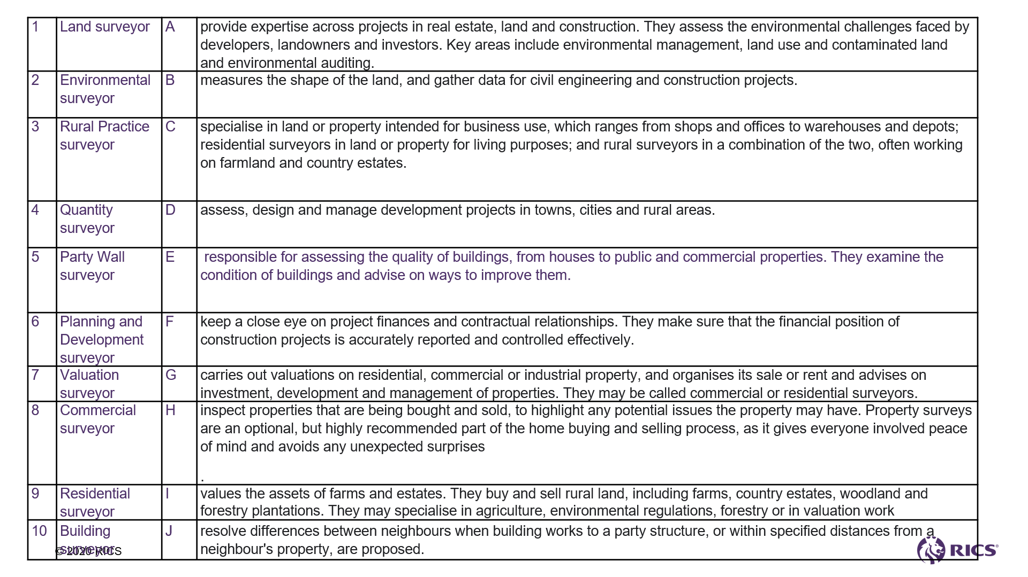


Slide 17


Want to be
involved?
rics.org/careers
Information, advice and profiles of RICS members offering you an insight into the world of a chartered surveyor
Email – careers@rics.org

Slide 18
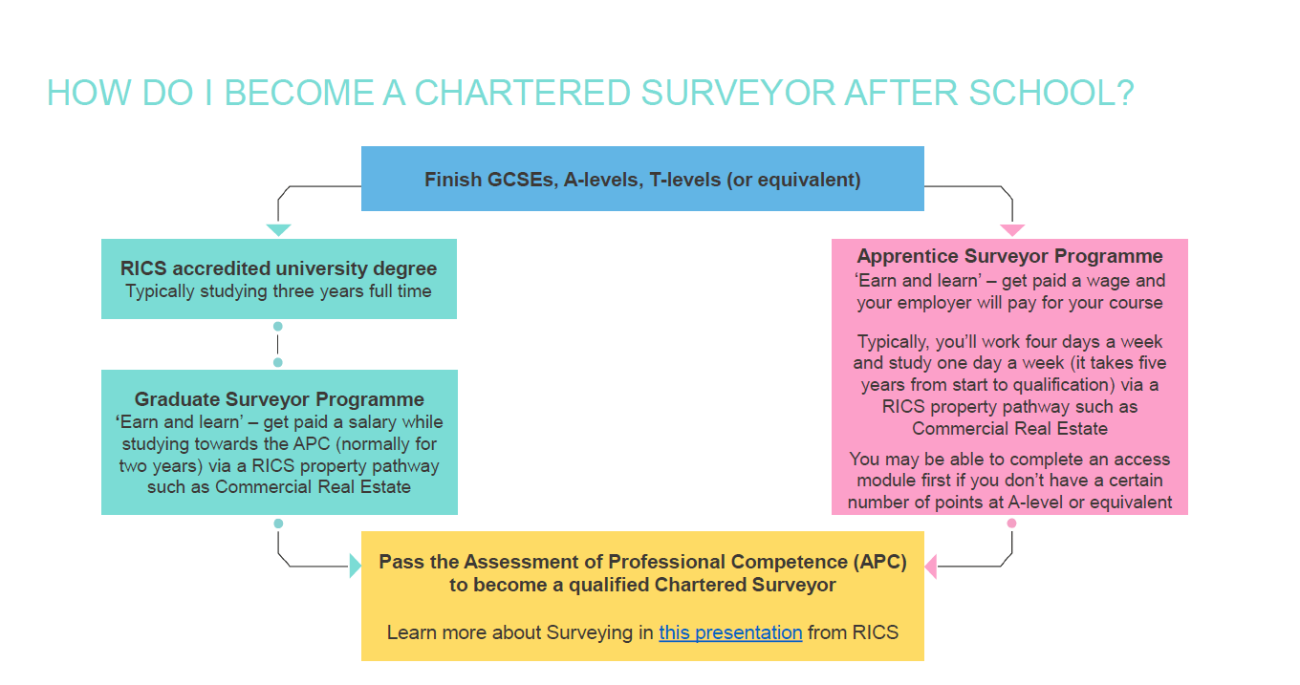

Routes to surveying
GCSEs
A levels x 3 a T level DSP Level 3 apprenticeship
Any old degree
Surveying degree or a level 6 apprenticeship
Post grad conversion degree
Chartership

Slide 19



Connectr
Head over to our new learning platform, Connectr on which you can:
Identify the key tasks undertaken by a surveyor by completing our on-line modules
Understand the role a surveyor plays in developing land and constructing and managing buildings by playing Megacity
Evaluate your readiness to commence a pathway into surveying by taking part in a RICS competition
Create your career action plan following your chat with a mentor
Notes:
If you enjoyed today's activity and would like to find out more about a career within surveying, you can head over to our new learning platform which offers further information on surveying. Your teacher will share this QR code with you after the session.
There is also an opportunity to speak to digital mentors online, you can ask any questions about a career in the built environment.
Ambassador, please familiarise yourself with Connectr: RICS student learning portal - Connectr

Slide 20

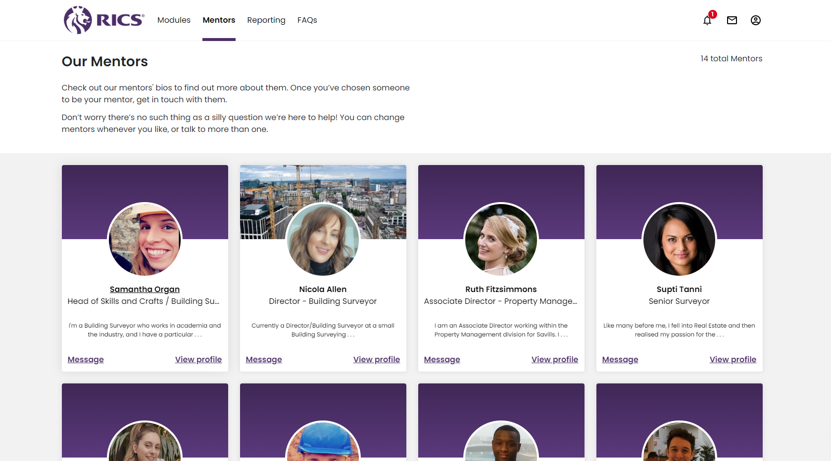
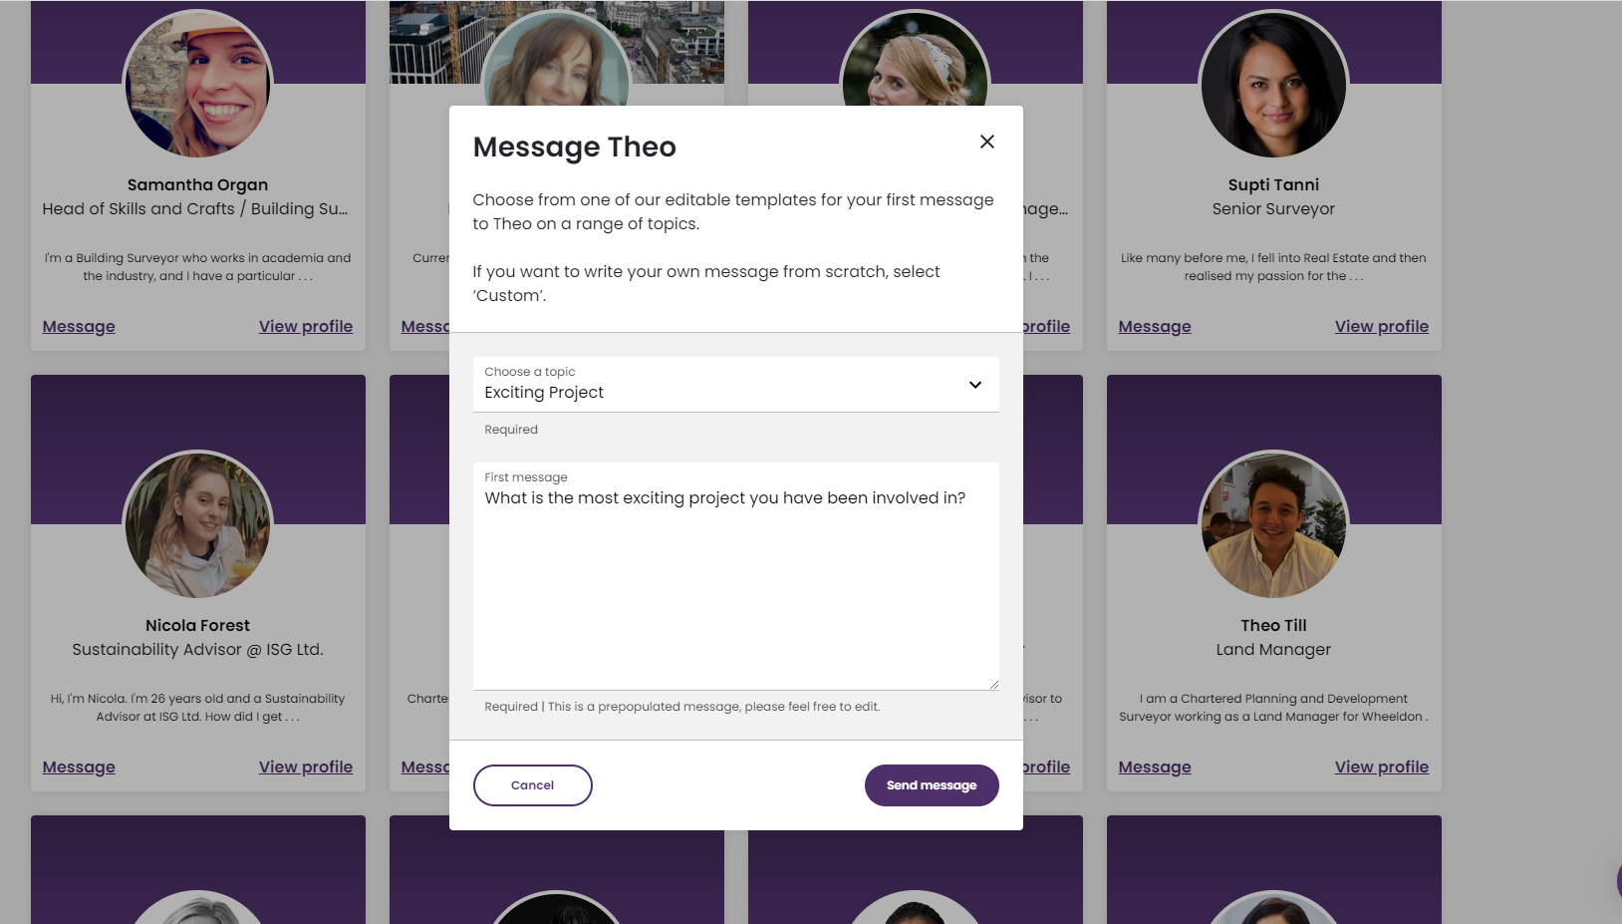

Connectr with RICS Mentors
WRITE ME
DOWN
bit.ly/rics22
SCAN ME
Notes:
Thank you, do you have any questions?

Slide 21
Over to you!
You are all surveyors. One major concern is the planet. Design a community centre made from sustainable materials.

Slide 22

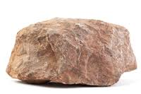
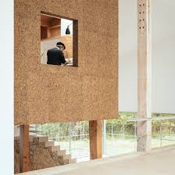
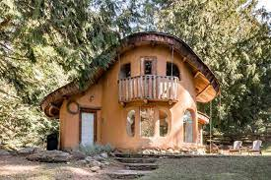
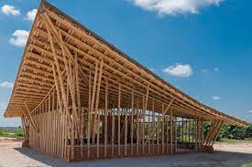
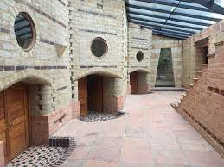
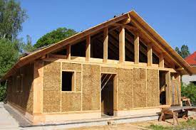
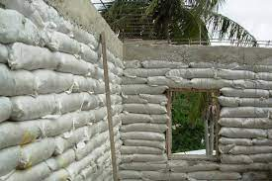
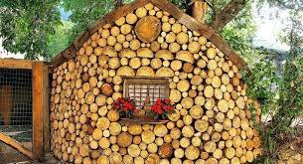
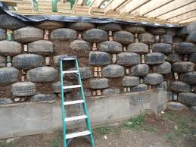
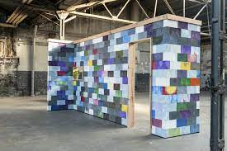
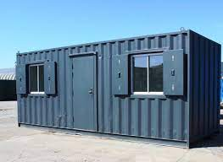
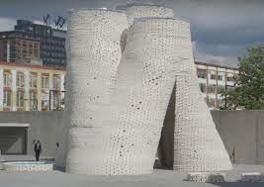

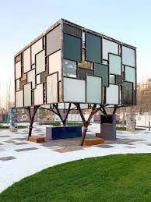
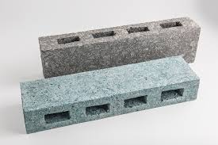
Sustainable building materials
1
3
4
2
5
6
7
8
11
12
10
9
13
14
15

Slide 23
Plenary:
1) What does a surveyor do?
2) What does RICS stand for?
3) what is RICS?
4) Tell us about your sustainable build.
Notes:
Hopefully they know more now than they did at the start.

Slide 24
Thank you.

